Slide 1
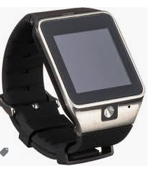
Hand-Washing Smart Watch
ECE 211/212 - Summer 2020
Team: Gabrielle, Jana, Garth, Zheng

Slide 2
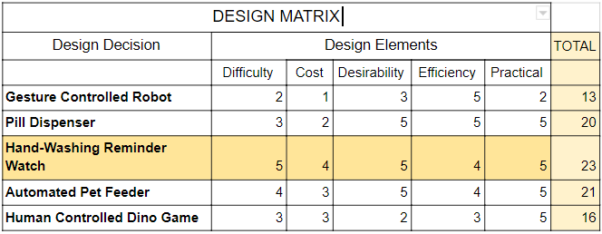
DESIGN MATRIX

Slide 3
DESIGN MATRIX

Slide 4

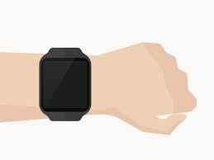
WHAT?
Notes:
This watch is to help keep up good hygiene practices as well as act as a normal watch, that is able to transmit data to another device.

Slide 5
WHAT?
Notes:
This watch is to help keep up good hygiene practices as well as act as a normal watch, that is able to transmit data to another device.

Slide 6
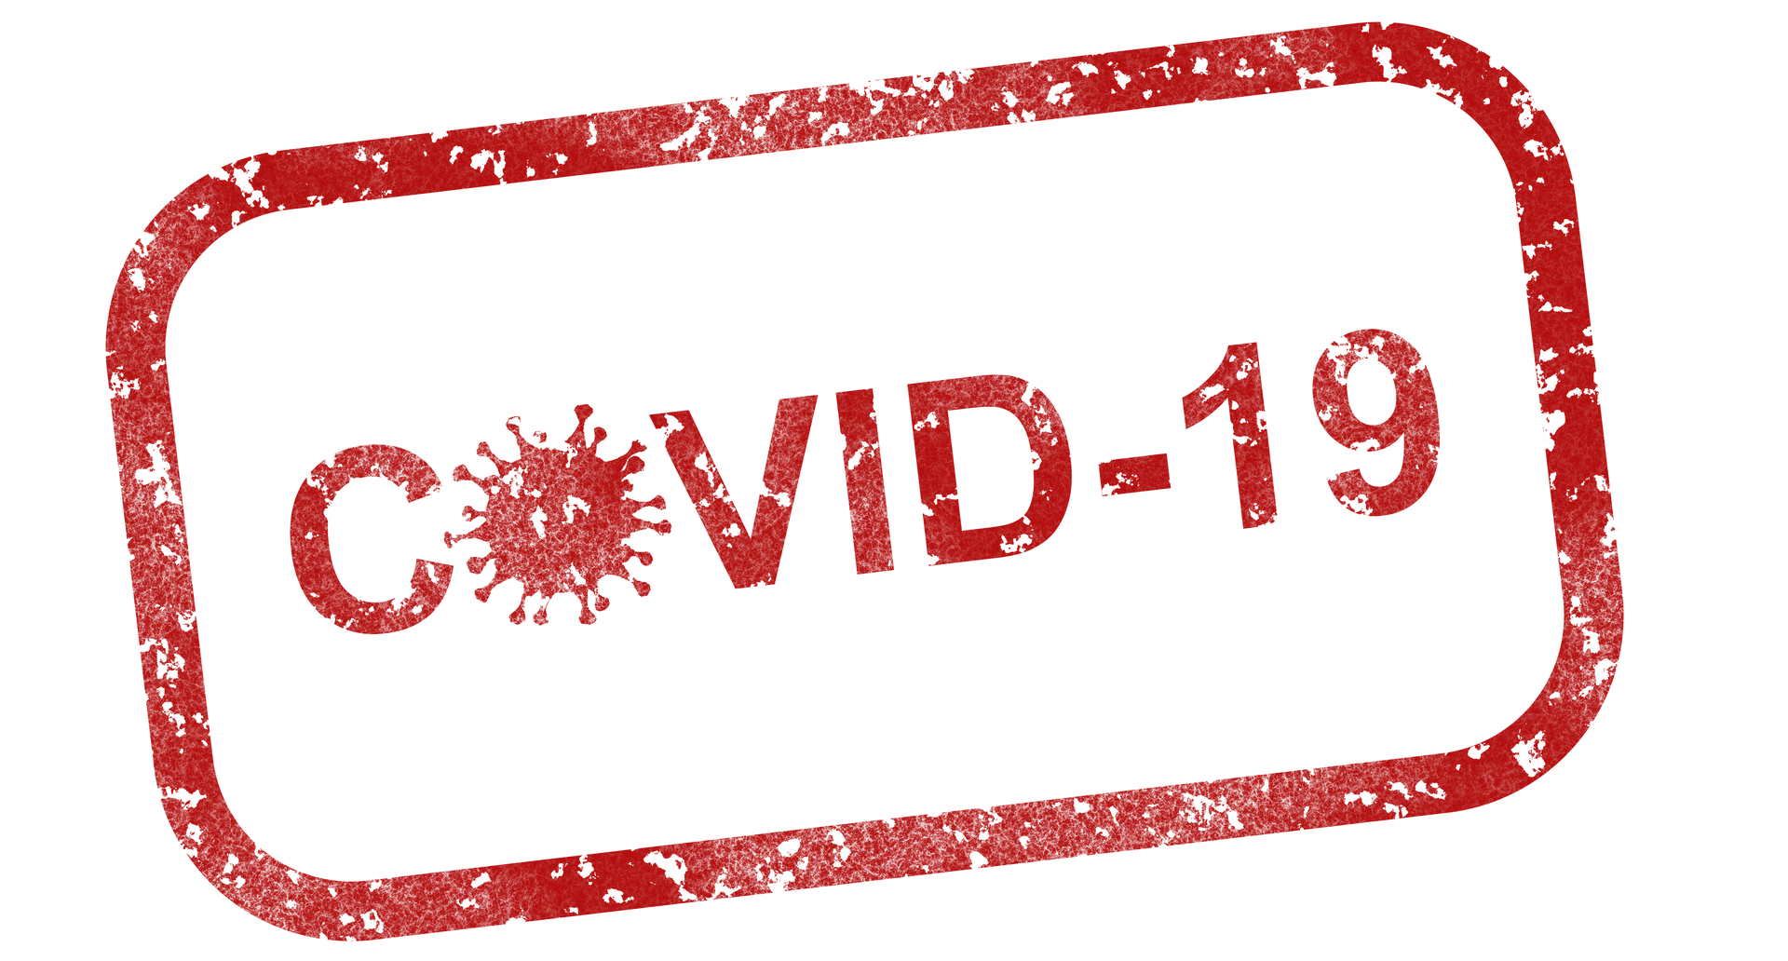
WHY?
Notes:
In light of the current pandemic, having a watch with the hand-washing feature is a great way to create and maintain health and hygiene habits such as washing your hands when possible.

Slide 7
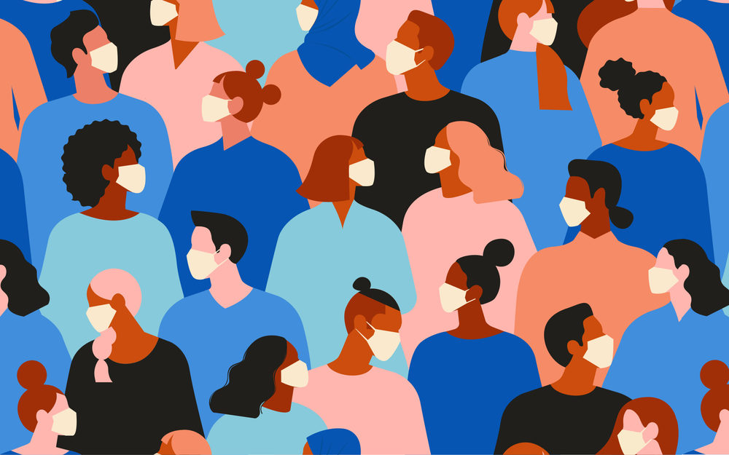
WHO?
For Everyone!
Notes:
Our Hand wash reminder watch will be Suitable for all ages. With Coronavirus affecting our lives, developing hand washing habits is so important to everyone. We hope this project can help people to practice good hygiene habits and awareness. This applied to people of all ages, and will especially be useful to parents who are wanting to track their child’s hygiene habits. The watch will also act as a teacher to the kid, indicating to them how long they must wash their hands for.

Slide 8
WHO?
For Everyone!
Notes:
Our Hand wash reminder watch will be Suitable for all ages. With Coronavirus affecting our lives, developing hand washing habits is so important to everyone. We hope this project can help people to practice good hygiene habits and awareness. This applied to people of all ages, and will especially be useful to parents who are wanting to track their child’s hygiene habits. The watch will also act as a teacher to the kid, indicating to them how long they must wash their hands for.

Slide 9
HOW?
Materials Anticipated:
-Buzzer
-LED’s
-Push button
-Uno board
-Water resistant product
-Mini Tray Compartment
-Display Screen
-Wrist band
Notes:
The watch will function as a regular watch in addition to reminding the user to wash their hands throughout the day and count down the recommended time of doing so. When the watch reaches the set time, buzzers will emit a sound to remind the user, and at the same time the LED light will light up. In order to achieve these functions, we need the materials in the above list, We will also update the list of subsequent feature development

Slide 10
HOW?
Materials Anticipated:
-Buzzer
-LED’s
-Push button
-Uno board
-Water resistant product
-Mini Tray Compartment
-Display Screen
-Wrist band
Notes:
The watch will function as a regular watch in addition to reminding the user to wash their hands throughout the day and count down the recommended time of doing so. When the watch reaches the set time, buzzers will emit a sound to remind the user, and at the same time the LED light will light up. In order to achieve these functions, we need the materials in the above list, We will also update the list of subsequent feature development

Slide 11
HOW?
Materials Anticipated:
-Buzzer
-LED’s
-Push button
-Uno board
-Water resistant product
-Mini Tray Compartment
-Display Screen
-Wrist band
Notes:
The watch will function as a regular watch in addition to reminding the user to wash their hands throughout the day and count down the recommended time of doing so. When the watch reaches the set time, buzzers will emit a sound to remind the user, and at the same time the LED light will light up. In order to achieve these functions, we need the materials in the above list, We will also update the list of subsequent feature development

Slide 12
Main Requirements
Shows the time in a 24-hour and 12-hour format
Notify user when to wash their hands
Timer for washing hands
Water Resistant
Collect and transmit data about frequency of hand washing per day to another device (ei. Android via bluetooth or cloud)
Notes:
For our final prototype, our goal is to have a fully functioning watch that can display both a 12-hour clock or a 24-hour clock, as well as remind the user to wash their hands, how long to wash their hands for, and collect that data so that the user will be able to track how often their hands get washed within a day.
This is an especially useful function with the climate we are in now with co
vid, as well as something useful to parents who want to track how often their child practices good hygiene.

Slide 13
Main Requirements
Shows the time in a 24-hour and 12-hour format
Notify user when to wash their hands
Timer for washing hands
Water Resistant
Collect and transmit data about frequency of hand washing per day to another device (ei. Android via bluetooth or cloud)
Notes:
For our final prototype, our goal is to have a fully functioning watch that can display both a 12-hour clock or a 24-hour clock, as well as remind the user to wash their hands, how long to wash their hands for, and collect that data so that the user will be able to track how often their hands get washed within a day.
This is an especially useful function with the climate we are in now with covid, as well as something useful to parents who want to track how often their child practices good hygiene.

Slide 14
Difficulties
Creating the program that will be able to have all the functions described
Writing the code
Compiling and debugging code to ensure there are no errors
Constructing a prototype of the design
3D printing
Circuit design and implementation
Bluetooth/Cloud compatibility
Notes:
Some difficulties we expect to experience during the making of our prototypes are figuring out the code to make each special function work, how to debug our code, and how to combine all our ideas together into one functioning item. We anticipate needing to use a 3D printer or buy some parts and tools to make the final product.

Slide 15
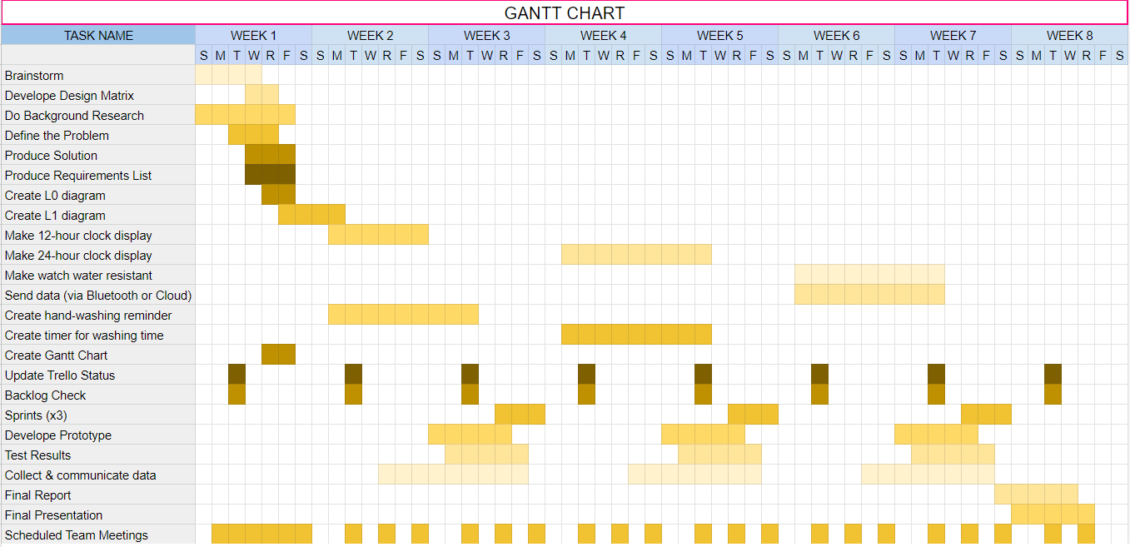

Slide 16
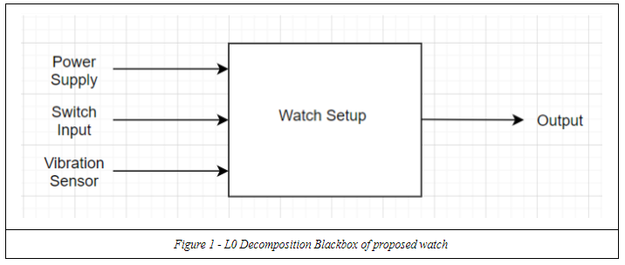
Level: 0 Decomposition

Slide 17
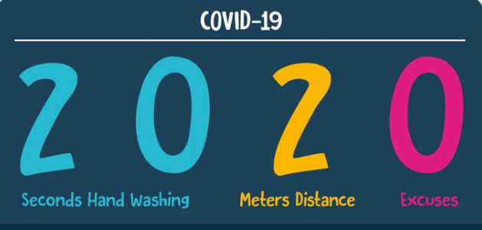
CONCLUSION
12-hour and 24-hour clock
Fight disease with hand-washing reminder
Record wash time
Track hand-washing daily
Waterproof
For all ages

Slide 18
CONCLUSION
The hand washer reminder prototype was made using an Arduino Uno with a grove - vibration sensor with a smart device app.
Whenever a person washes his/her hands after the set alarm goes off, the vibration sensor detects hand washing gestures and triggers the reset of the Arduino board for 20 seconds.
It was designed to run on smart devices to provide reminders and automatically keep track of each hand wash data.
Regular hand washing is widely recognized as the most effective means to combat the spread of infectious illness/ viruses such as COVID-19. We as a team thinks it is a highly scalable project and overcomes most limitations for an individual.

Slide 19
Questions?

Slide 20
DIY Hand Wash Reminder. (n.d.). Retrieved from https://create.arduino.cc/projecthub/Mukesh_Sankhla/diy-hand-wash-reminder-3b2ceb?ref=platform&ref_id=424_trending__beginner_&offset=28
GodsTale, & Instructables. (2017, October 17). Make Your Own Smart Watch. Retrieved from https://www.instructables.com/id/Make-your-own-smart-watch/
“When and How to Wash Your Hands.” Centers for Disease Control and Prevention, Centers for Disease Control and Prevention, 2 Apr. 2020, www.cdc.gov/handwashing/when-how-handwashing.html.
REFERENCES

